Slide 1
Primal-Dual Algorithm

Slide 2
Self-reducibility
Incremental
Dynamic Program
Divide-and-Conquer
Primal
Primal-Dual
Local
Ratio
Greedy

Slide 3
Primal-Dual
An optimality condition comes from the primal-dual theorem e.g., max-flow=min-cut.
Start from a pre-solution satisfying the optimality condition.
A pre-solution is not feasible, but approaching to feasibility step by step.
Eventually, the pre-solution becomes a feasible solution which is optimal.

Slide 4
Primal-Feasible
Consider a maximization problem
Optimality condition:
Max Primal = Min Dual
Optimal solution
Primal feasible solutions

Slide 5
Dual Feasible
Consider a maximization problem
Dual feasible solutions
coincide with pre-primal solution
Optimal solution
Optimality condition:
Max Primal = Min Dual

Slide 6
Lecture 16
Max Flows 3
Preflow-Relable Algorithms

Slide 7
Review

Slide 8
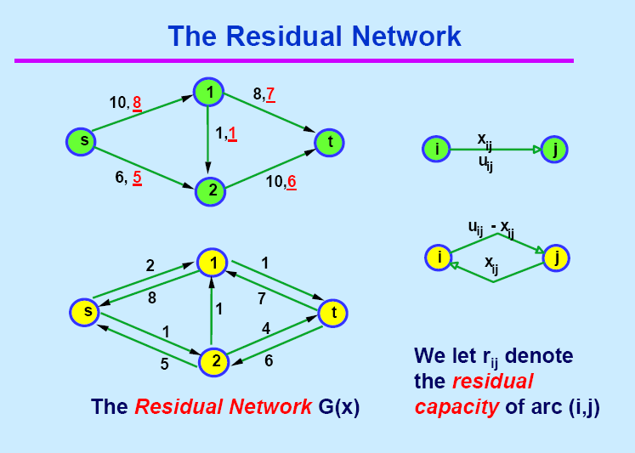

Slide 9
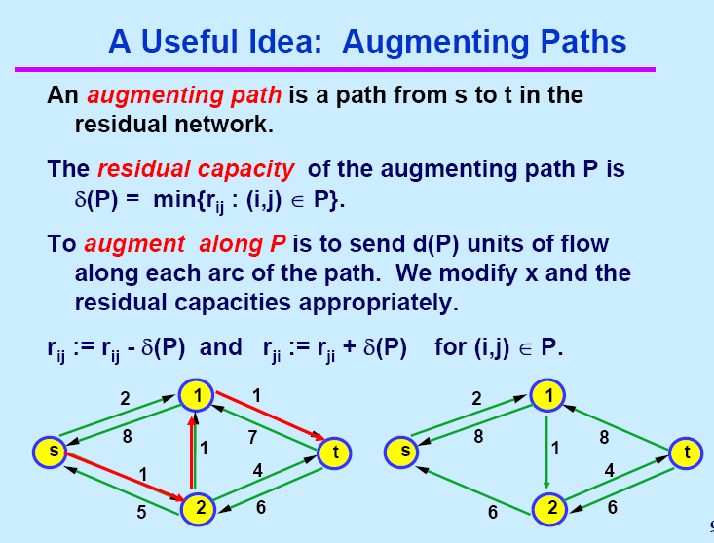

Slide 10
The Ford Fulkerson Maximum Flow Algorithm
Begin x := 0;
  create the residual network G(x);
  while there is some directed path from s to t in G(x) do
    begin
    let P be a path from s to t in G(x);
    ∆:= δ(P);
    send ∆ units of flow along P;
    update the r's;
  End
end {the flow x is now maximum}.

Slide 11
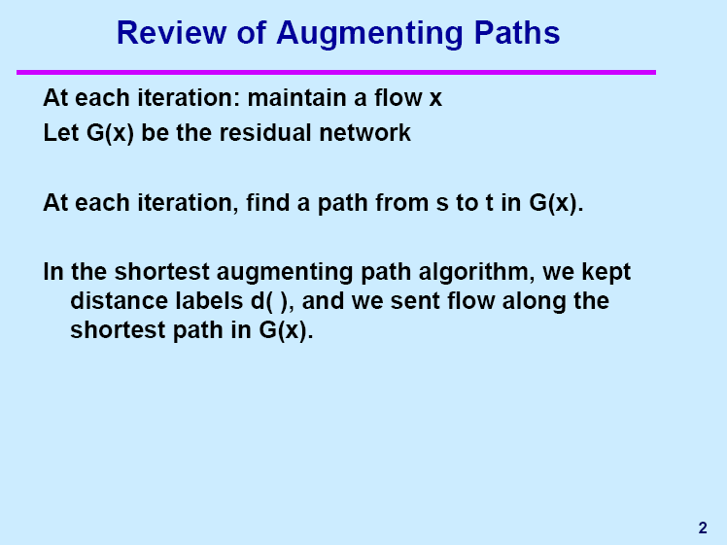

Slide 12
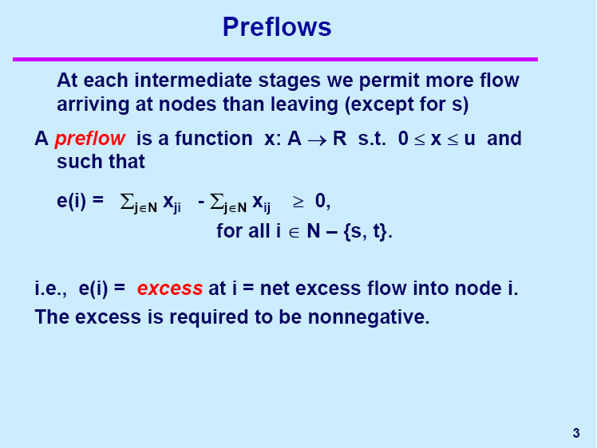

Slide 13
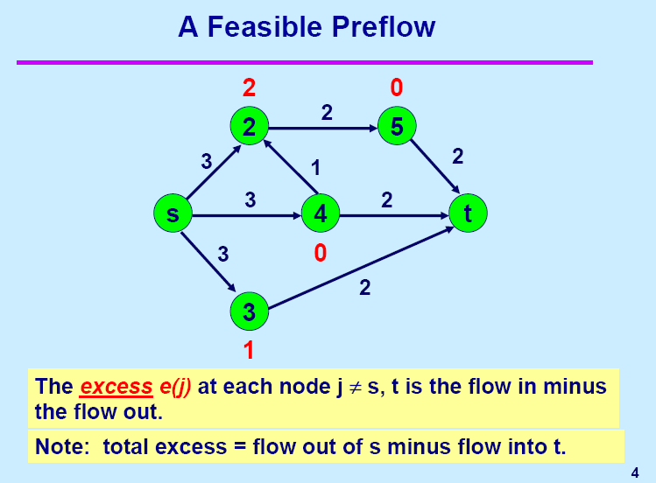

Slide 14
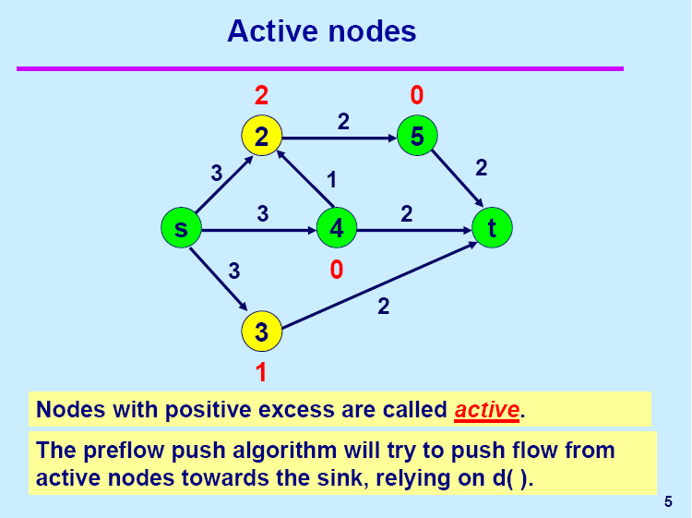

Slide 15
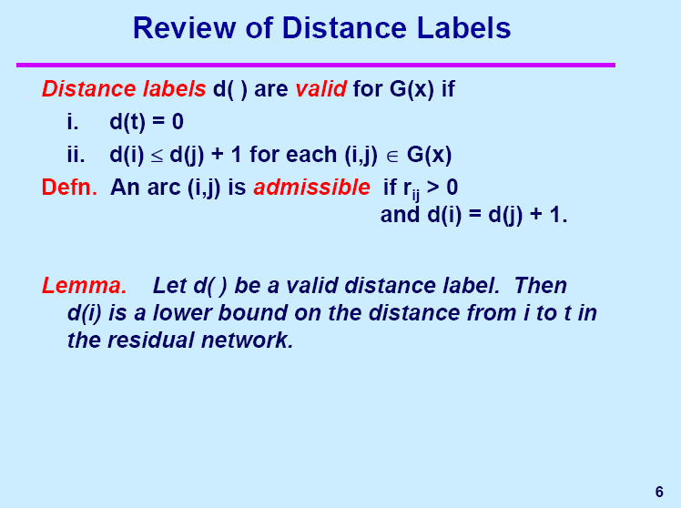
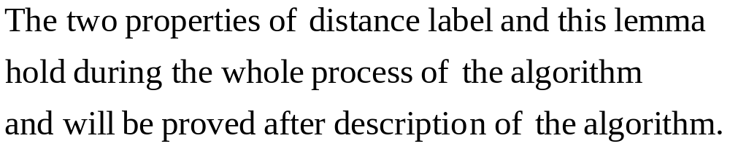

Slide 16
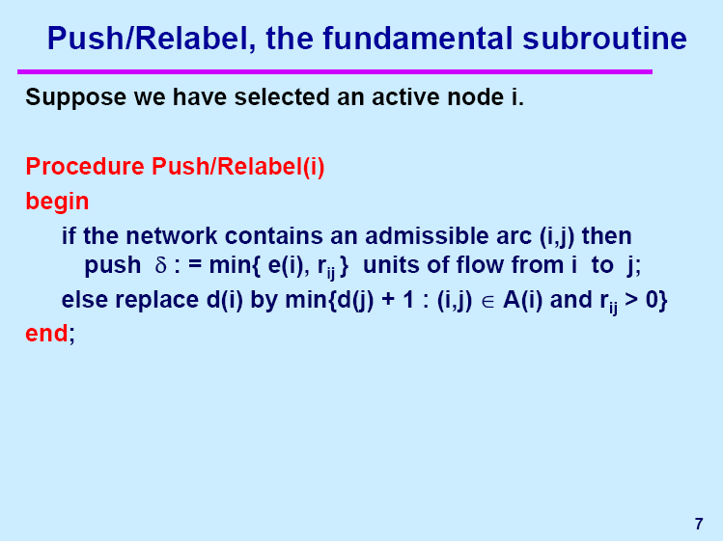

Slide 17
Push: Saturating
4
3
2
1
1
3
3
2
1

Slide 18
Push: Non-Saturating
3
4
2
1
0
3
1
2
1
3

Slide 19
Relabel
2
3
4
Min{3,5}+1=4
2
3
5
1
1
1
2
3
4
4
3
5
1
1
1

Slide 20
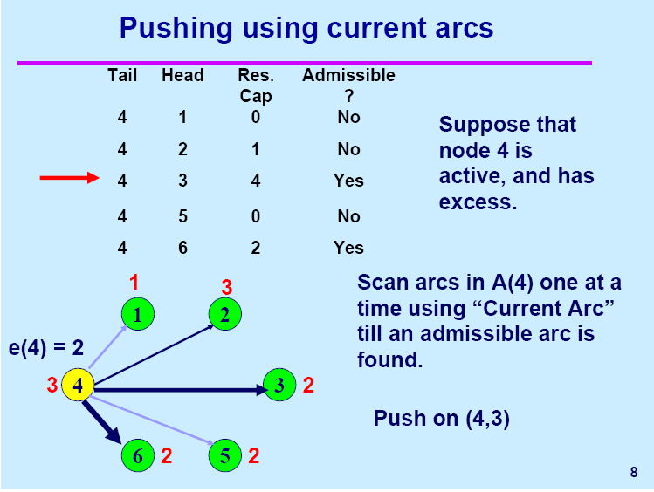
e(3)=1

Slide 21
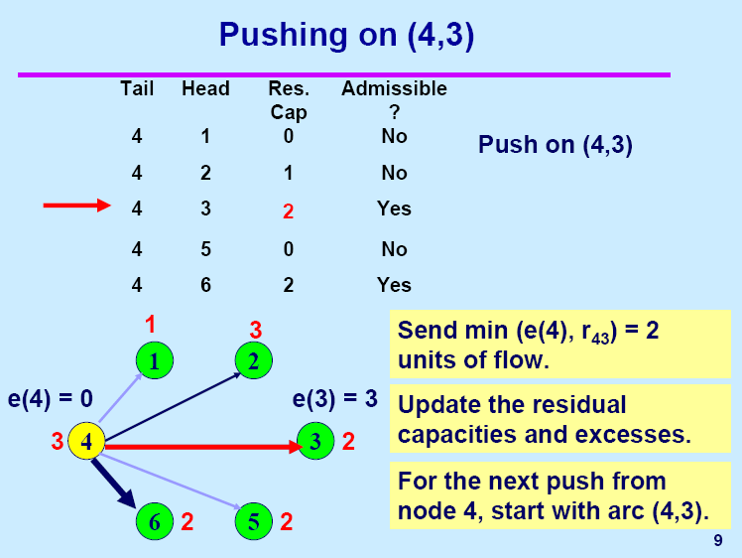

Slide 22
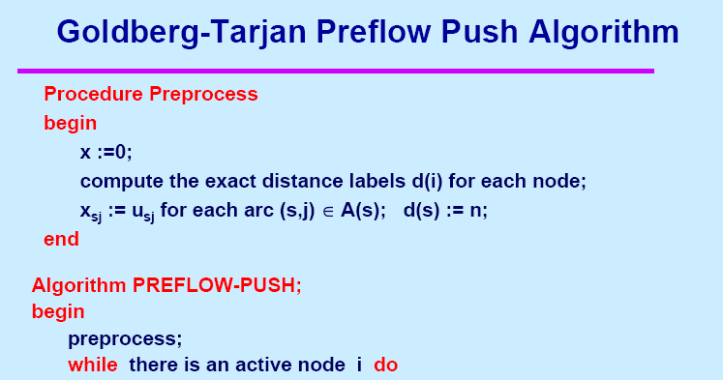
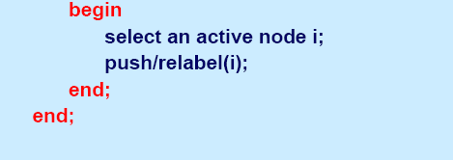

Exact distance: d(i) equals the length of the shortest path from node i to node t in G(x)

Slide 23
The Goldberg-Tarjan Preflow Push Algorithm for the Maximum Flow Problem
Notes:
Obtain a network, and use the same network to illustrate the shortest path problem for communication networks, the max flow problem, the minimum cost flow problem, and the multicommodity flow problem. This will be a very efficient way of introducing the four problems. (Perhaps under 10 minutes of class time.)

Slide 24
Preflow Push
4
2
5
3
1
1
1
2
4
s
4
t
3
2
1
3
This is the original network, plus reversals of the arcs.

Slide 25
Preflow Push
4
2
5
3
1
1
1
2
4
s
4
t
3
2
1
3
This is the original network, and the original residual network.

Slide 26
Initialize Distances
4
2
2
5
1
5
3
1
1
1
4
2
4
3
s
2
4
1
t
0
2
2
s
3
2
1
1
3
4
5
3
1
0
t
The node label henceforth will be the distance label.
d(j) is at most the distance of j to t in G(x)

Slide 27
Saturate Arcs out of node s
3
s
4
2
2
2
5
1
5
3
1
1
1
4
2
4
3
s
2
6
4
1
1
t
0
2
2
3
2
2
s
s
2
1
1
3
3
4
4
5
3
1
1
0
t
3
Saturate arcs out of node s.
Move excess to the adjacent arcs
Relabel node s after all incident arcs have been saturated.

Slide 28
Select, then relabel/push
3
s
4
2
2
2
5
1
5
3
1
1
1
4
2
4
3
s
2
6
4
1
1
t
0
2
2
s
3
2
s
2
1
1
3
4
5
3
1
1
1
0
t
3
1
Select an active node, that is, one with excess
Push/Relabel
Update excess after a push

Slide 29
Select, then relabel/push
3
s
4
2
2
2
5
1
5
3
1
1
1
4
2
4
3
s
2
6
4
1
1
t
0
2
2
s
3
s
3
2
1
1
3
3
4
5
2
3
1
1
1
2
0
t
1
Select an active node, that is, one with excess
No arc incident to the selected node is admissible. So relabel.

Slide 30
Select, then relabel/push
3
s
4
2
2
2
5
1
5
3
1
1
1
4
2
4
3
s
2
6
4
1
1
t
0
2
2
s
3
s
3
3
2
3
1
1
4
5
2
2
2
2
0
t
1
1
Select an active node, that is, one with excess
Push/Relabel

Slide 31
Select, then relabel/push
3
3
3
s
4
1
2
2
2
2
2
5
1
1
5
3
3
1
1
1
4
2
4
3
s
2
6
4
1
1
t
0
2
2
3
2
s
s
3
2
3
1
1
4
5
5
2
2
2
0
t
1
1
Select an active node.
Push/Relabel

Slide 32
Select, then relabel/push
3
2
s
4
1
2
2
2
2
5
1
1
5
3
3
1
1
1
4
2
4
3
s
2
6
4
1
1
t
0
2
2
s
3
s
3
2
3
1
1
4
5
2
2
2
0
t
1
1
Select an active node.
Push/Relabel

Slide 33
Select, then relabel/push
3
2
s
4
1
2
2
2
2
5
1
1
2
5
3
3
1
1
4
1
2
4
3
s
2
6
4
1
1
t
0
2
2
s
3
s
3
5
2
3
1
1
4
5
5
2
2
2
0
t
1
1
Select an active node.
There is no incident admissible arc. So Relabel.

Slide 34
Select, then relabel/push
3
2
1
s
4
1
2
2
2
2
5
1
2
2
5
3
3
1
1
4
1
2
4
3
s
2
6
4
1
1
t
0
2
2
s
3
s
3
5
2
3
4
1
1
4
2
2
2
0
t
1
1
Select an active node.
Push/Relabel

Slide 35
Select, then relabel/push
3
2
1
s
4
1
2
2
2
2
5
1
2
2
3
5
3
3
1
1
4
1
2
4
3
5
s
2
6
4
1
1
t
0
2
2
s
3
s
3
5
5
2
3
4
1
1
4
2
2
2
0
t
1
1
Select an active node.
There is no incident admissible arc. So relabel.

Slide 36
Select, then relabel/push
3
2
1
s
4
1
2
2
2
2
5
1
2
2
3
3
5
3
3
1
1
4
1
2
4
3
5
s
2
6
4
1
1
t
0
2
2
s
3
s
3
2
3
4
1
1
4
5
5
2
2
2
0
t
1
1
Select an active node.
Push/Relabel

Slide 37
Select, then relabel/push
1
s
4
2
2
2
2
2
5
1
2
2
3
3
5
2
3
1
1
4
1
2
4
3
5
s
2
6
4
1
1
1
1
t
0
2
2
s
3
s
3
2
3
4
4
1
1
4
4
5
5
2
2
2
0
t
1
1
Select an active node.
Push/Relabel

Slide 38
Select, then relabel/push
1
s
4
2
2
2
2
2
2
4
5
1
2
2
3
3
5
2
3
1
1
4
2
1
2
4
3
5
s
2
6
4
1
1
t
0
2
2
3
2
s
s
3
2
3
4
4
1
1
4
5
5
2
2
2
0
t
1
1
Select an active node.
Push/Relabel

Slide 39
Select, then relabel/push
1
s
4
2
2
2
2
2
4
4
5
1
2
2
3
3
5
2
3
1
1
4
2
1
2
4
3
5
s
2
6
4
1
1
t
0
2
3
s
3
s
2
3
4
4
1
1
4
5
5
2
2
2
0
t
1
1
Select an active node.
Push/Relabel

Slide 40
Select, then relabel/push
1
s
4
1
2
2
2
2
4
4
5
1
2
2
3
3
3
5
5
5
3
3
1
1
4
2
1
2
4
3
5
5
s
2
6
4
1
1
t
0
2
3
s
3
s
2
3
4
4
1
1
4
5
5
2
2
2
0
t
1
1
Select an active node.
Push/Relabel

Slide 41
Select, then relabel/push
1
s
4
1
2
2
2
2
4
4
5
1
2
2
3
3
3
5
5
5
3
3
1
1
4
2
1
2
4
3
5
5
s
2
6
4
1
1
t
0
2
3
s
3
s
2
3
4
4
1
1
4
5
5
2
2
2
0
t
1
1
One can keep pushing flow between nodes 2 and 5 until eventually all flow returns to node s.
There are no paths from nodes 2 and 5 to t, and there are ways to speed up the last iterations.

Slide 42
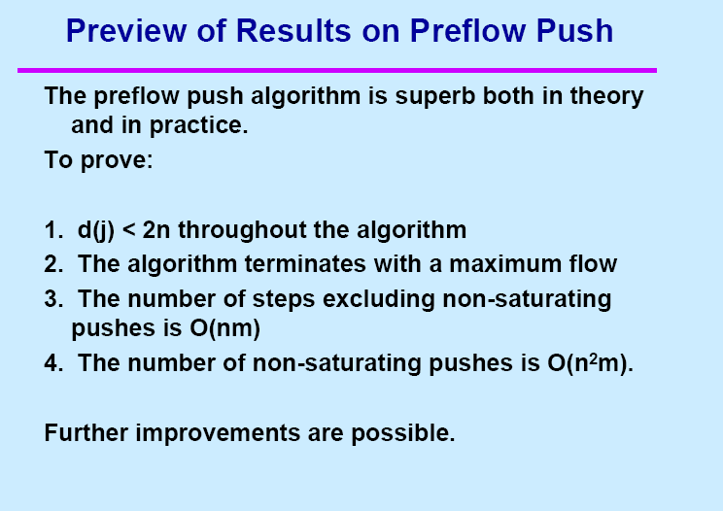

Slide 43
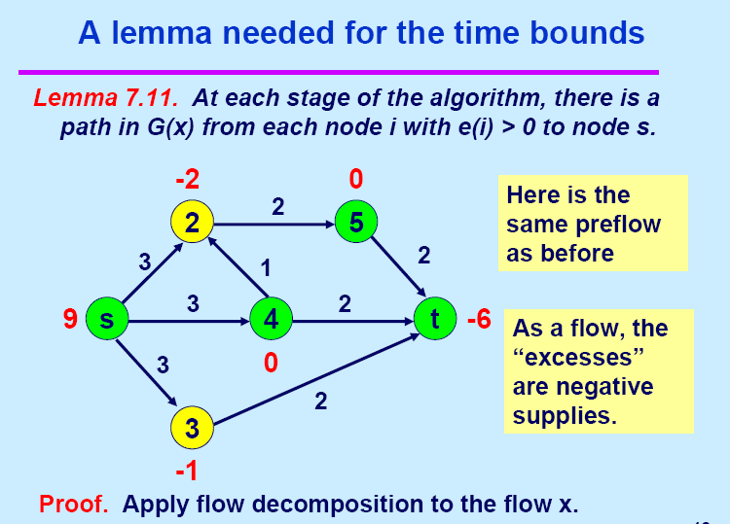

Slide 44
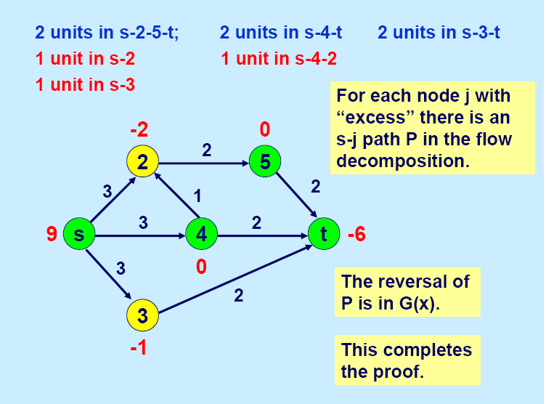

Slide 45


Slide 46
Push: Saturating
4
3
2
1
1
3
3
2
1

Slide 47
Push: Non-Saturating
3
4
2
1
0
3
1
2
1
3

Slide 48
Relabel
2
3
4
Min{3,5}+1=4
2
3
5
1
1
1
2
3
4
4
3
5
1
1
1

Slide 49
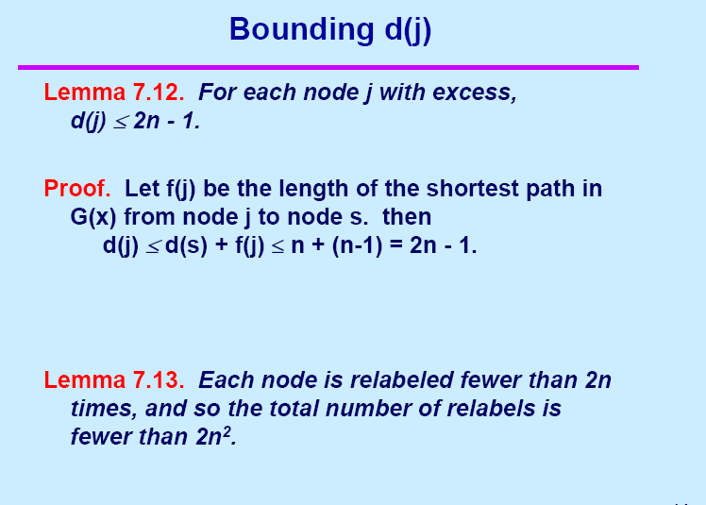

Slide 50
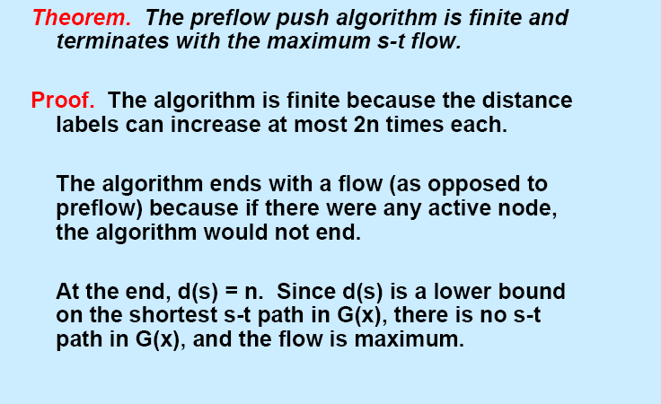

Slide 51
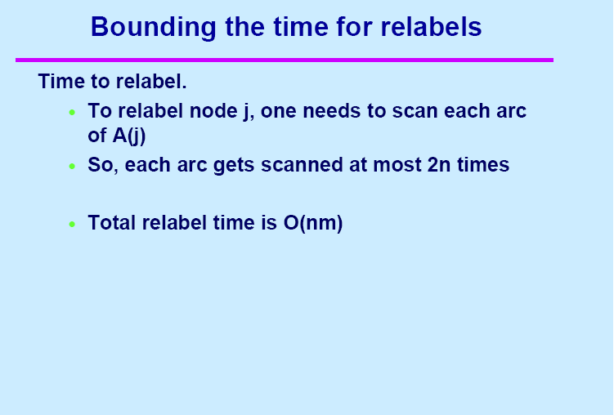

Slide 52
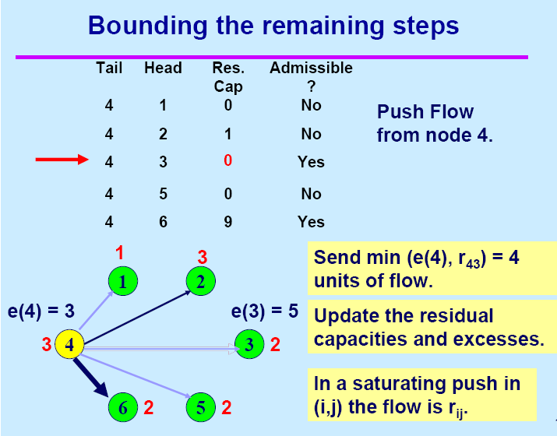

Slide 53
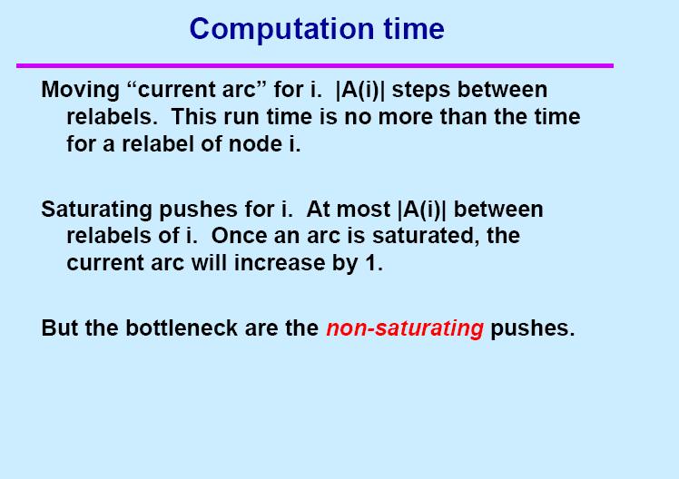

Slide 54
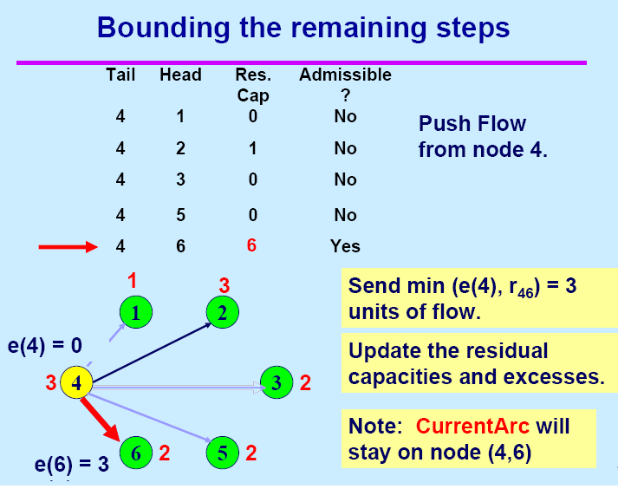

Slide 55
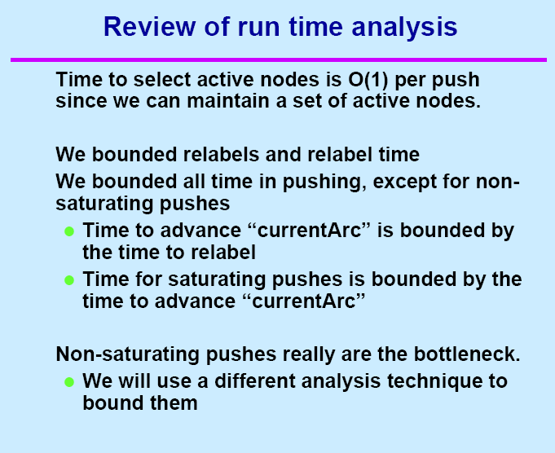

Slide 56
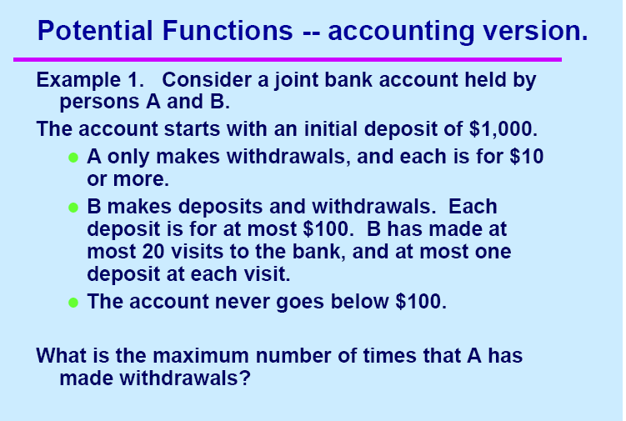

Slide 57
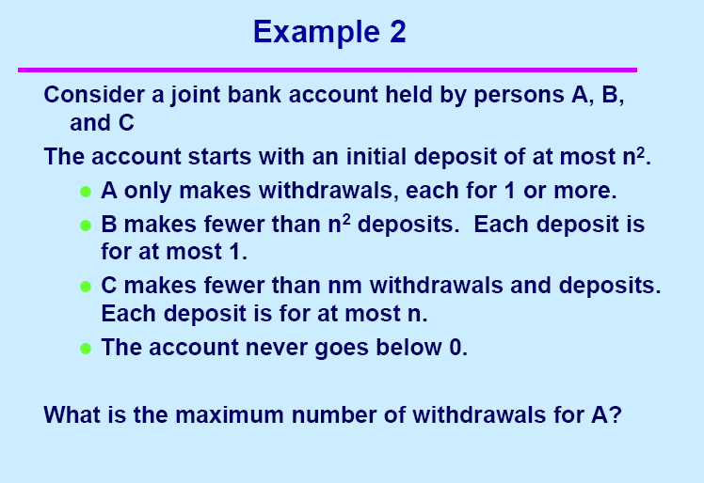

Slide 58
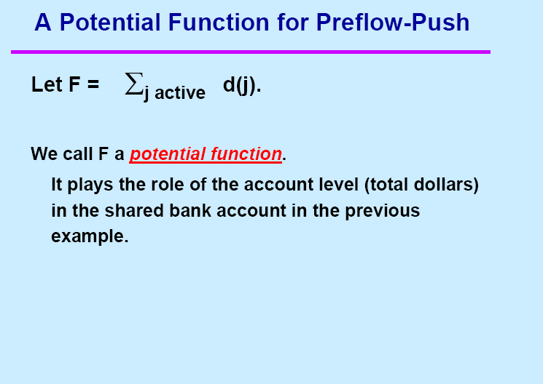

Slide 59
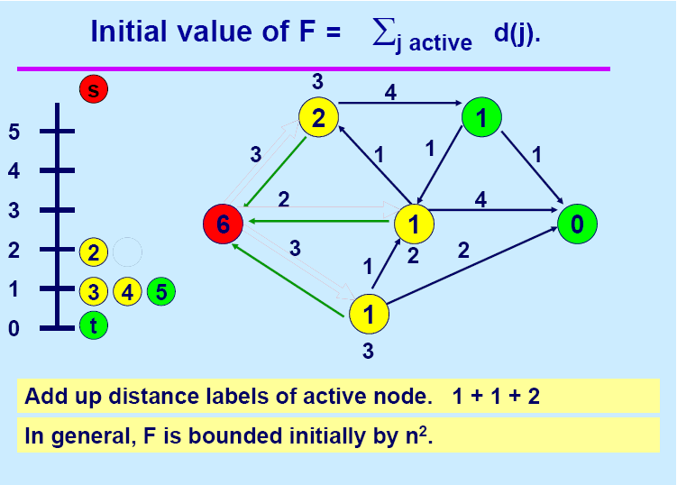

Slide 60
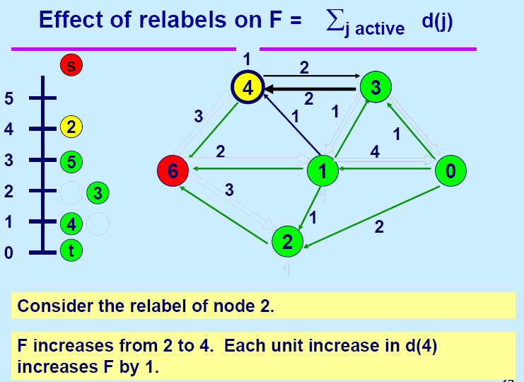

Slide 61
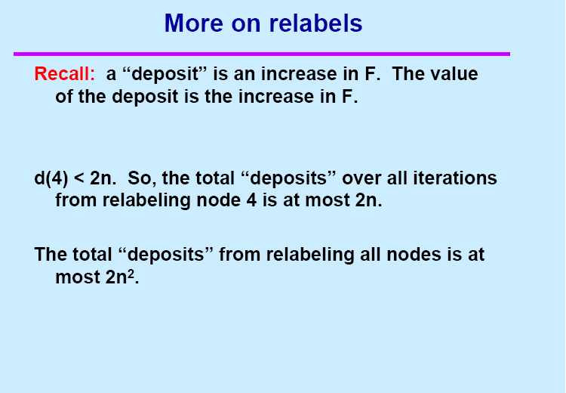

Slide 62
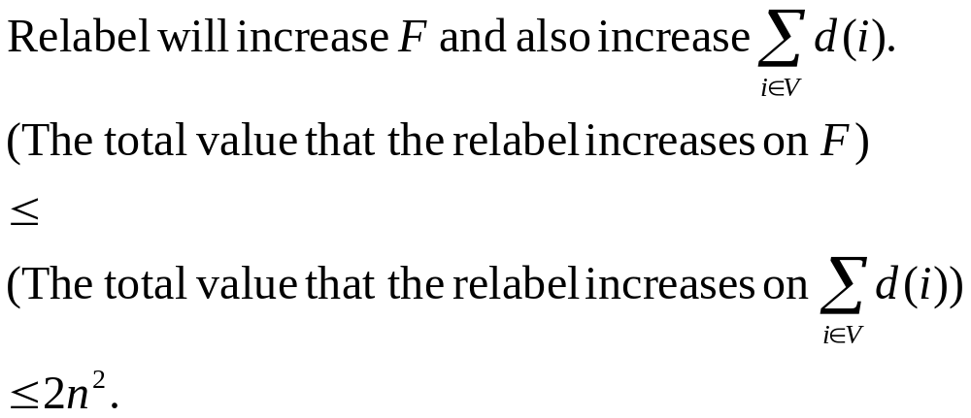
Relabel
2
3
4
2
3
5
1
1
1
2
3
4
4
3
5
1
1
Min{3,5}+1=4
1

Slide 63
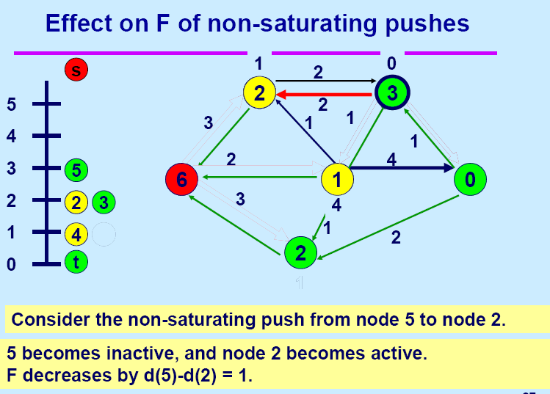

Slide 64
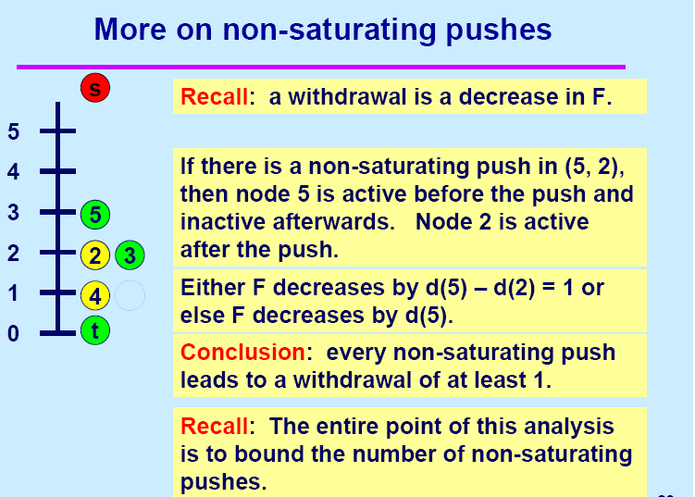

Slide 65

Push: Non-Saturating
Case 1
Case 2
3
4
3
1
4
2
1
2
1
0
3
0
4
1
1
2
1
2
1
3
3

Slide 66
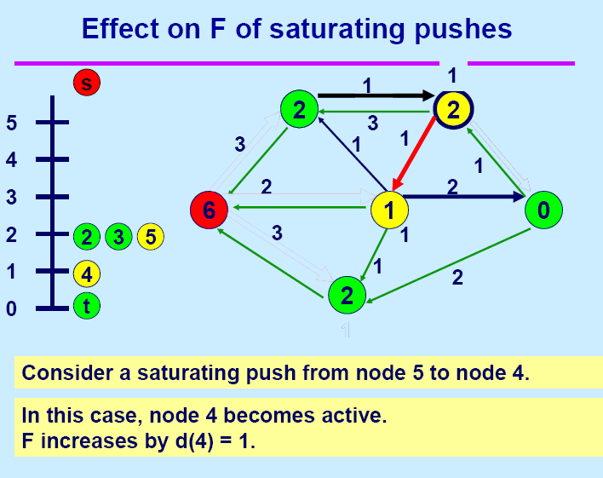

Slide 67
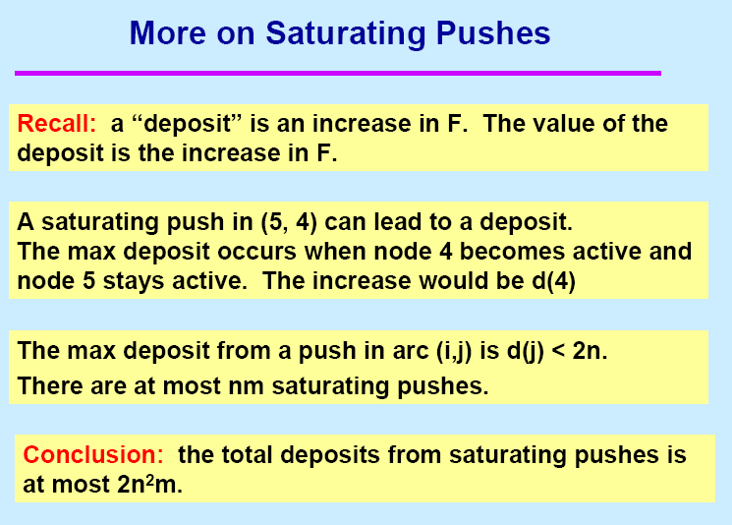

Slide 68
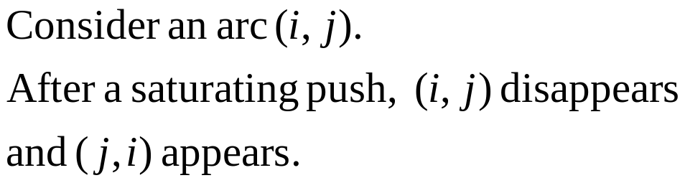

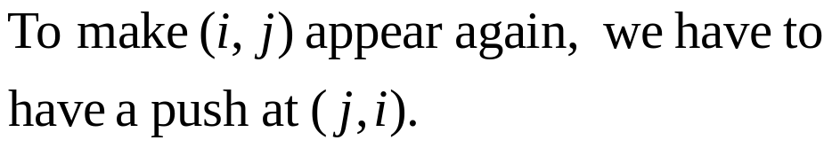

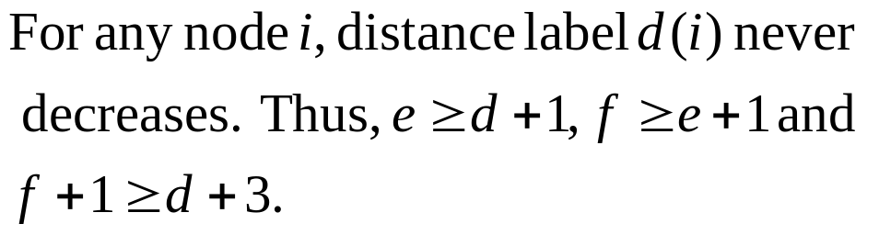


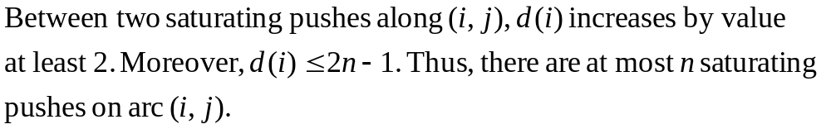
Why there are at most nm saturating Pushes?
4
3
4
1
3
3
1
3
3
4
3

Slide 69
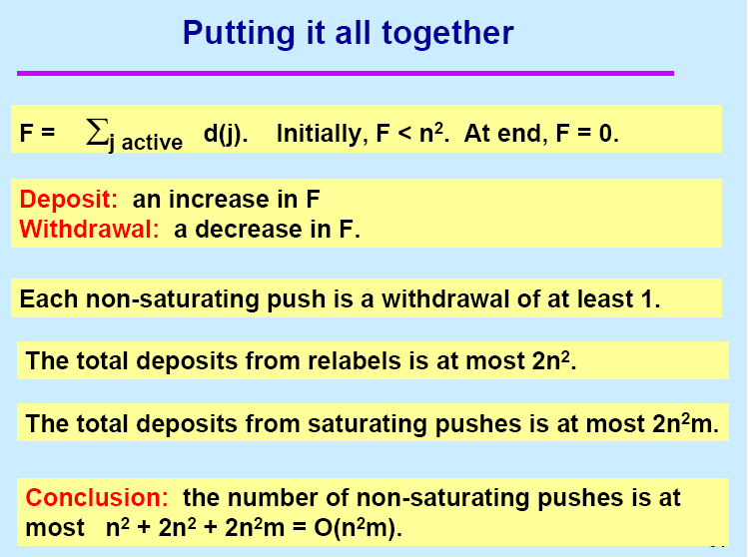

Slide 70
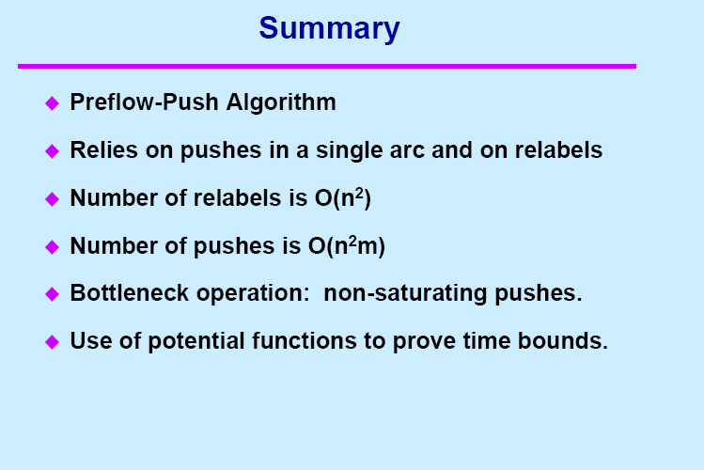

Slide 71
Assignments
Read sections 7.3 and 7.6
Exercises
7.4

